Slide 1
Omenn Syndrome and RAG1
Nicholas Moehn
Photo from: http://beyondessential.com/healthy-immune-system/

Slide 2
What is Omenn Syndrome?
http://en.wikipedia.org/wiki/Omenn_syndrome#mediaviewer/File:Omenn_syndrome.png
http://showyourhope.com/2012/11/04/

Slide 3
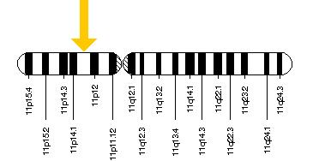
What causes Omenn Syndrome?
RAG1

Slide 4
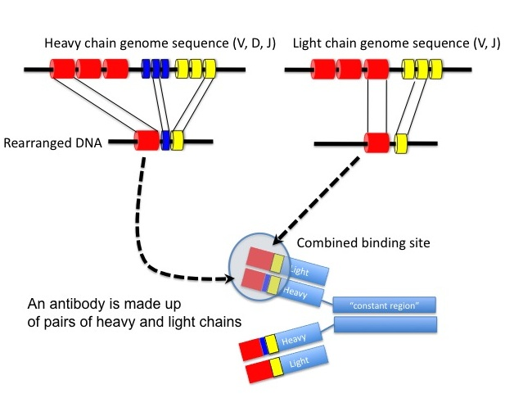
How does RAG1 work?

Slide 5
How well is RAG1 conserved?
AA
AA
99%
AA
90%
AA
76%
AA
75%
AA
59%

Slide 6
Where is RAG1 mutated in OS?

Slide 7
What organisms contain RAG1?

Slide 8
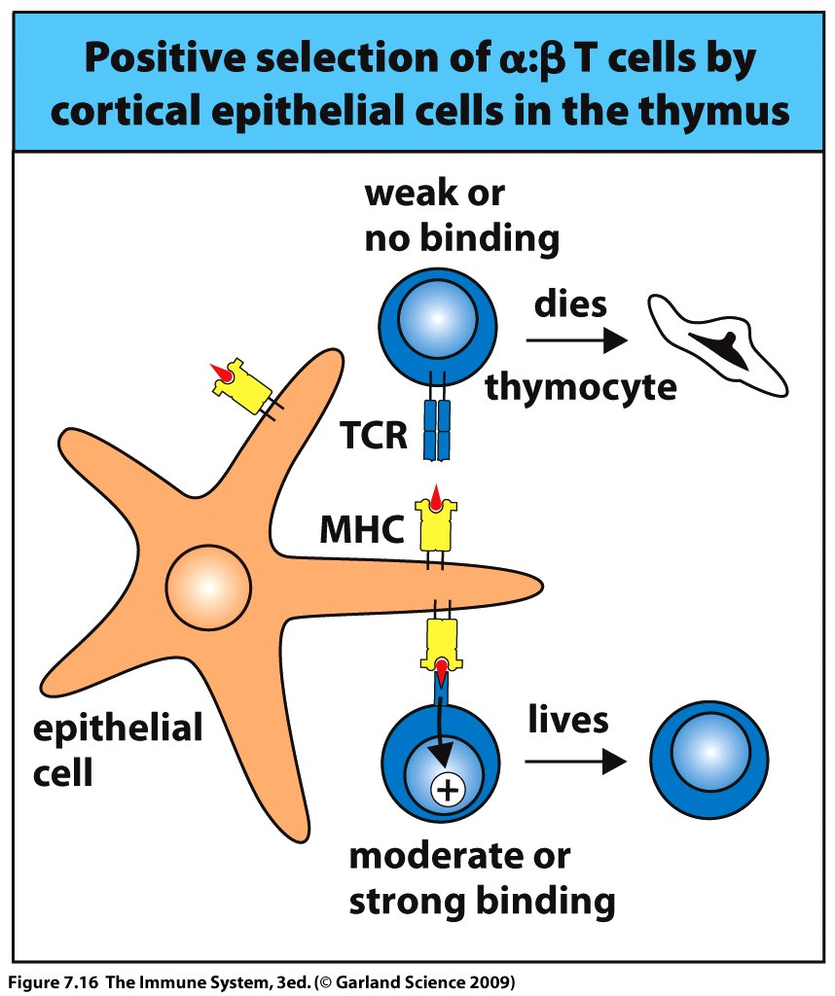
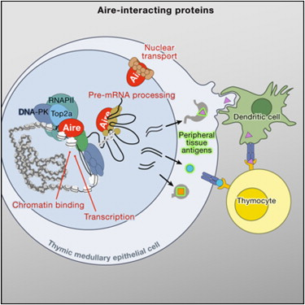
A possible second player?
Notes:
http://www.cell.com/abstract/S0092-8674(09)01616-X
http://course1.winona.edu/kbates/Immunology/chapter7-09_000.htm

Slide 9
What causes Omenn Syndrome?
Goal: To explore how AIRE and RAG1 contribute to the Omenn syndrome phenotype
Hypothesis: Mutations in RAG1, in combination with deficiency in AIRE, creates the small, oligoclonal population of self-reactive immune cells present in individuals with Omenn syndrome.

Slide 10
Aim 1: Determine if all individuals with Omenn syndrome are deficient for AIRE
Immunodeficiency
AIRE
RAG1
SCID
RAG1
Omenn Syndrome????
AIRE

Slide 11
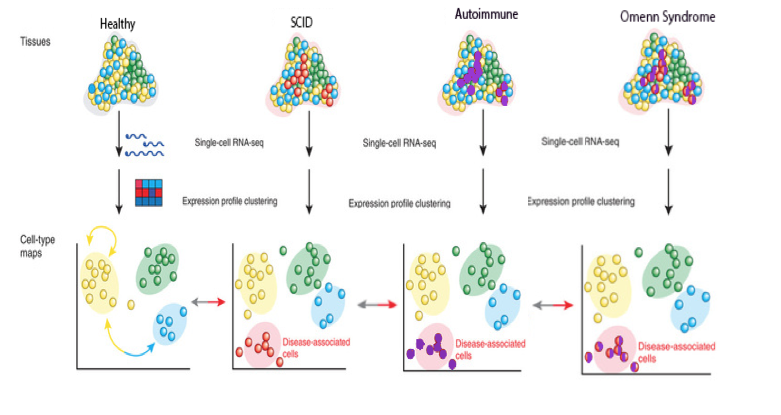
Approach: RNAseq
http://fcsanahuac.com/category/temas-selectos-de-ciencias-de-la-salud/

Slide 12
Aim 2: Identify mutations that would cause autoimmune symptoms
RAG1
AIRE

Slide 13
Approach: Next Gen Sequencing

Slide 14
Aim 3: Demonstrate that deficiency in RAG1 and AIRE is sufficient to cause OS
AIRE
Immunodeficiency
RAG1
SCID
RAG1
AIRE
Omenn Syndrome?

Slide 15
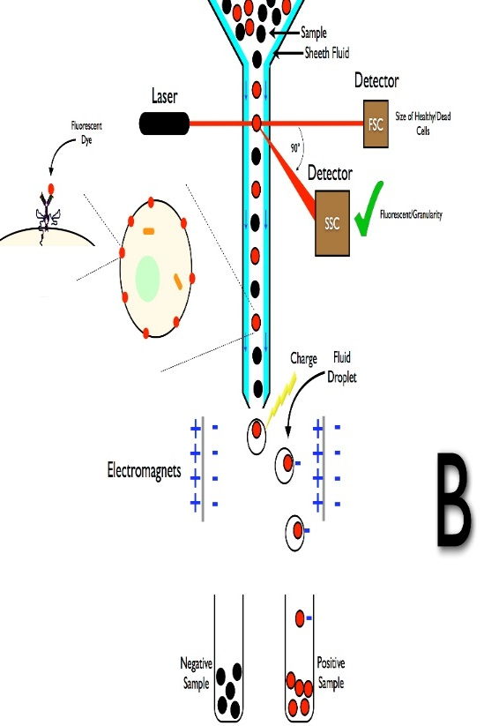
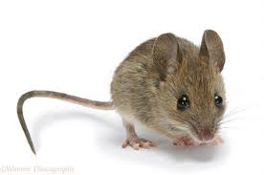
Approach: Crispr-Cas9 to create mutants
Crispr-Cas9
http://de.wikipedia.org/wiki/Durchflusszytometrie

Slide 16
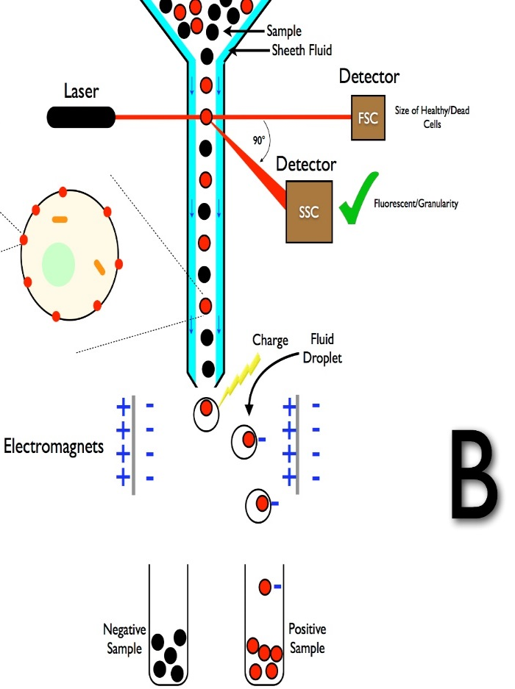
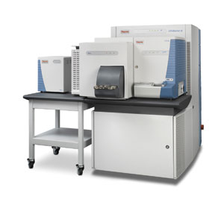
Approach: Quantitative proteomics and cell counting
Cell counts

Slide 17
Future Directions
Take advantage of the knowledge of AIRE mutation to try to develop a new treatment for patients with Omenn syndrome
To apply knowledge of Omenn syndrome to other SCIDs, immunodeficiencies, and autoimmune disease

