Slide 1
Omenn Syndrome and RAG1
Nicholas Moehn
Photo from: http://beyondessential.com/healthy-immune-system/

Slide 2
What is Omenn Syndrome?
http://en.wikipedia.org/wiki/Omenn_syndrome#mediaviewer/File:Omenn_syndrome.png
http://showyourhope.com/2012/11/04/

Slide 3
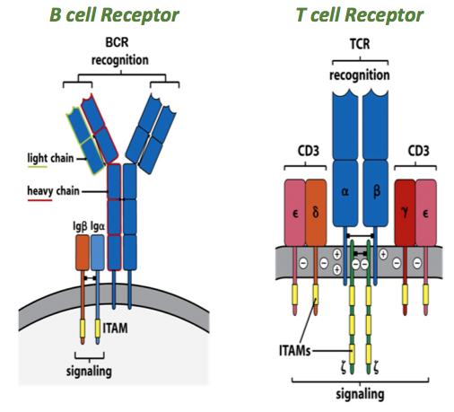
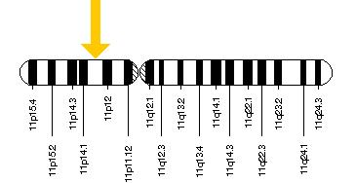
What causes Omenn Syndrome?
RAG1

Slide 4
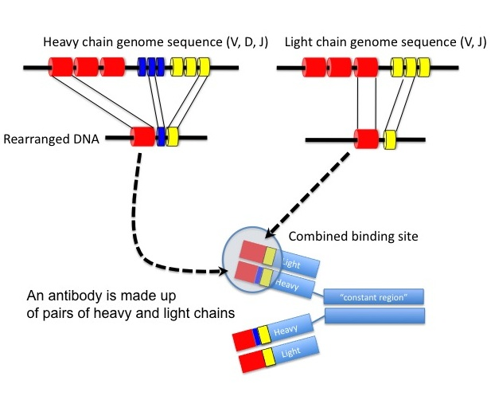
How does RAG1 work?
RAG1
RAG1 activates VDJ recombination

Slide 5
How well conserved is RAG1?
AA
AA
99%
AA
90%
AA
76%
AA
75%
AA
59%

Slide 6
RAG1 across species
Notes:
Make it more informative? Perhaps you could highlight/box the primate clade to show that the protein is very conserved among humans and primates, and mention what this implies for research.

Slide 7
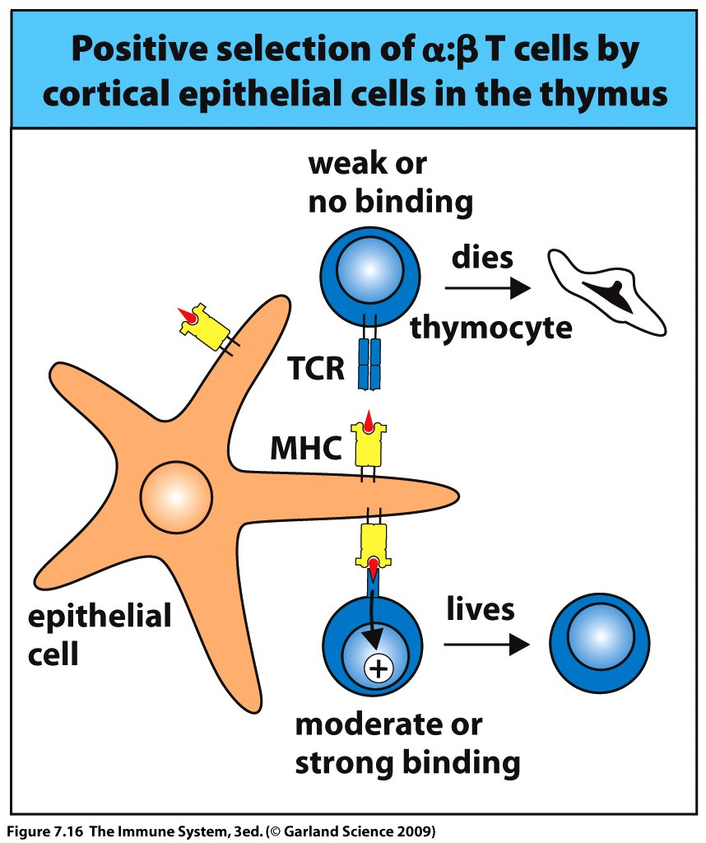
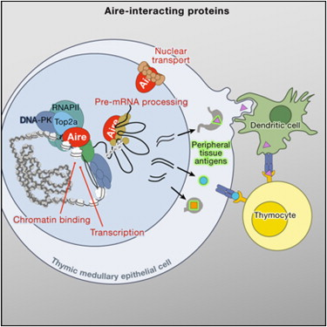
A possible second player?
Notes:
http://www.cell.com/abstract/S0092-8674(09)01616-X
http://course1.winona.edu/kbates/Immunology/chapter7-09_000.htm

Slide 8
What causes Omenn Syndrome?
Goal: To explore how AIRE and RAG1 contribute to the Omenn syndrome phenotype
Hypothesis: Mutations in RAG1, in combination with deficiency in AIRE, creates the small, oligoclonal population of self-reactive immune cells present in individuals with Omenn syndrome.
Notes:
Hypothesis could be a little less wordy

Slide 9
Aim 1: Determine if all individuals with Omenn syndrome are deficient for AIRE
RAG1
Severe-combined immunodeficiency
AIRE
RAG1
SCID
AIRE
Omenn Syndrome????
RAG1
AIRE

Slide 10
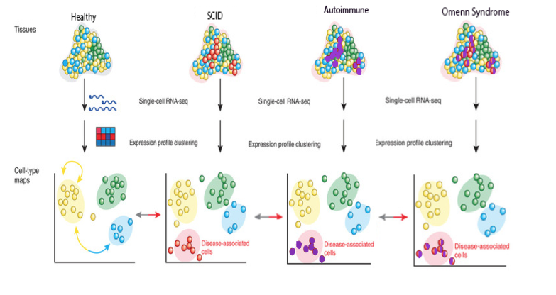
Approach: RNAseq
http://fcsanahuac.com/category/temas-selectos-de-ciencias-de-la-salud/

Slide 11
Aim 2: Identify mutations that would cause autoimmune symptoms
RAG1
AIRE

Slide 12
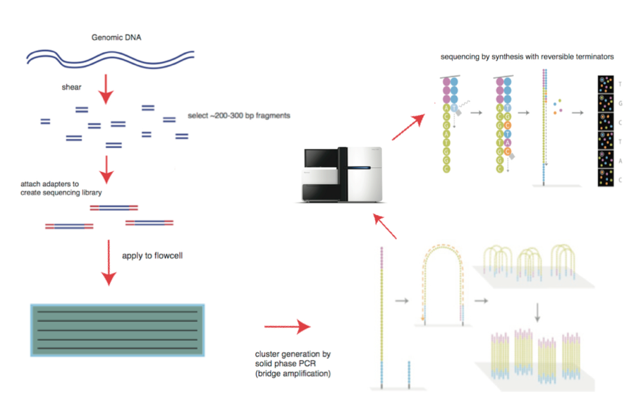
Approach: Next Gen Sequencing

Slide 13
Aim 3: Demonstrate that deficiency in RAG1 and AIRE is sufficient to cause OS
AIRE
Immunodeficiency
RAG1
SCID
RAG1
AIRE
Omenn Syndrome?

Slide 14
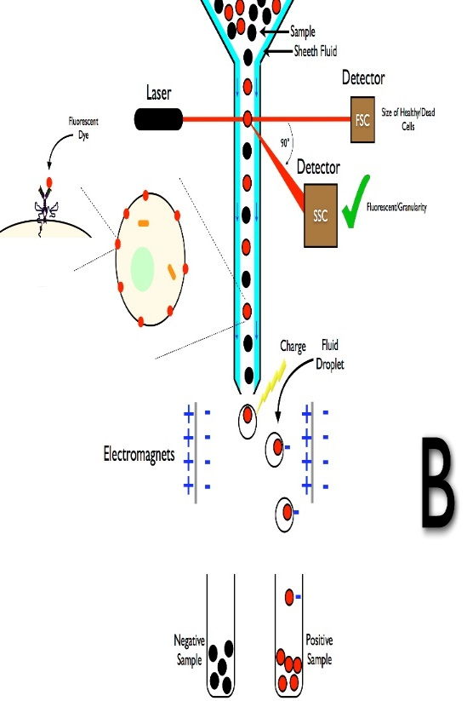
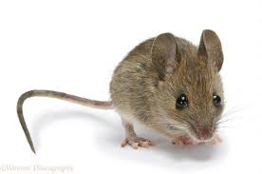
Approach: Crispr-Cas9 to create mutants
Crispr-Cas9
http://de.wikipedia.org/wiki/Durchflusszytometrie

Slide 15
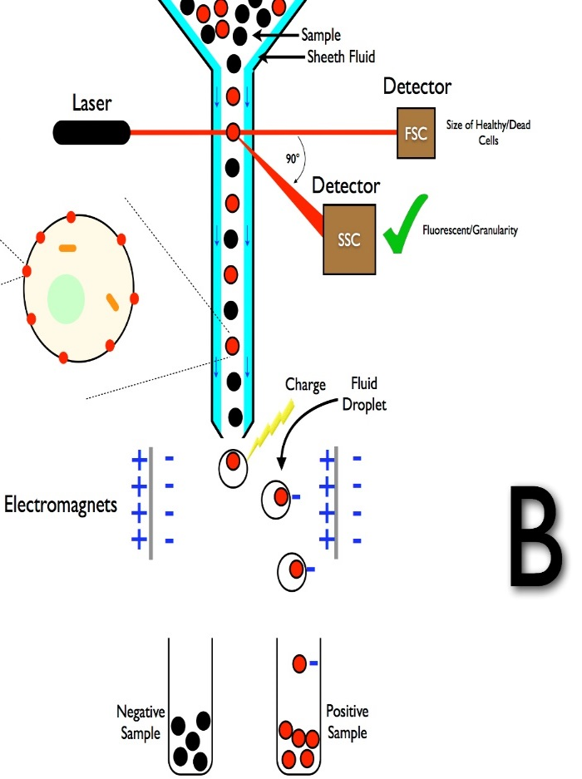
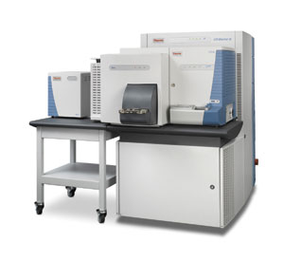
Approach: Quantitative proteomics and cell counting
Cell counts

Slide 16
Future Directions
Take advantage of the knowledge of AIRE mutation to try to develop a new treatment for patients with Omenn syndrome
To apply knowledge of Omenn syndrome to other SCIDs, immunodeficiencies, and autoimmune disease

